Slide 1




Technology Trend Analysis
Alejandro Sanhueza
12/07/2023

Slide 2




OUTLINE
Executive Summary
Introduction
Methodology
Results
Visualization – Charts
Dashboard
Discussion
Findings & Implications
Conclusion
Appendix

Slide 3


EXECUTIVE SUMMARY
Current Technology Usage Trend
Language
Database
Platform
Web frame
Future Technology Trend
Language
Database
Platform
Web frame
Demographics Survey
Country & Gender Difference

Slide 4


INTRODUCTION
Analyze technology trend in software and web development among developers around the world
Purpose of this Analysis
Identify the top programming languages, database, platform and web frame skills in demand
Identify skill requirements for future
Identify human resource gap in the industry
Audience for this Presentation
Programmers
IT industry leaders
Computer science students

Slide 5
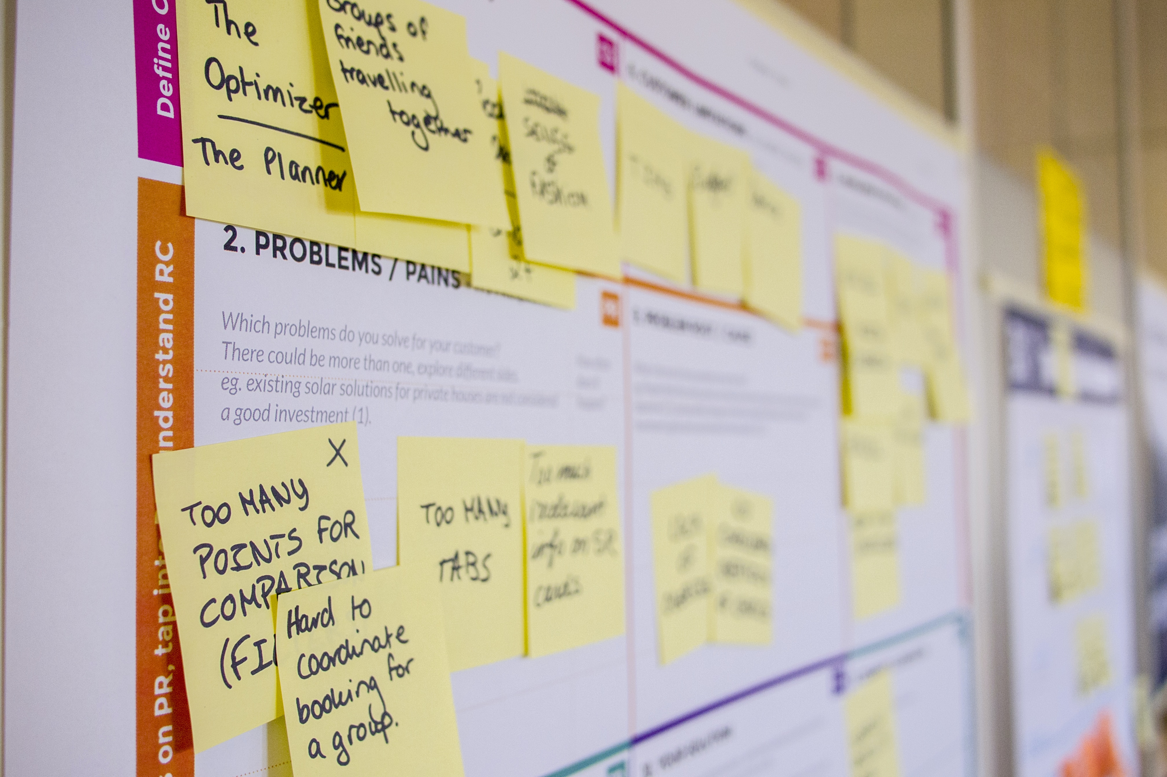

METHODOLOGY
Data Collection (Sources)
Stack overflow developer 2019 survey
GitHub job postings
Programming languages annual salary
Data Wrangling
Data Exploration
Data Cleaning
Data Visualization
Python matplotlib & seaborn
IBM Cognos
Presentation

Slide 6
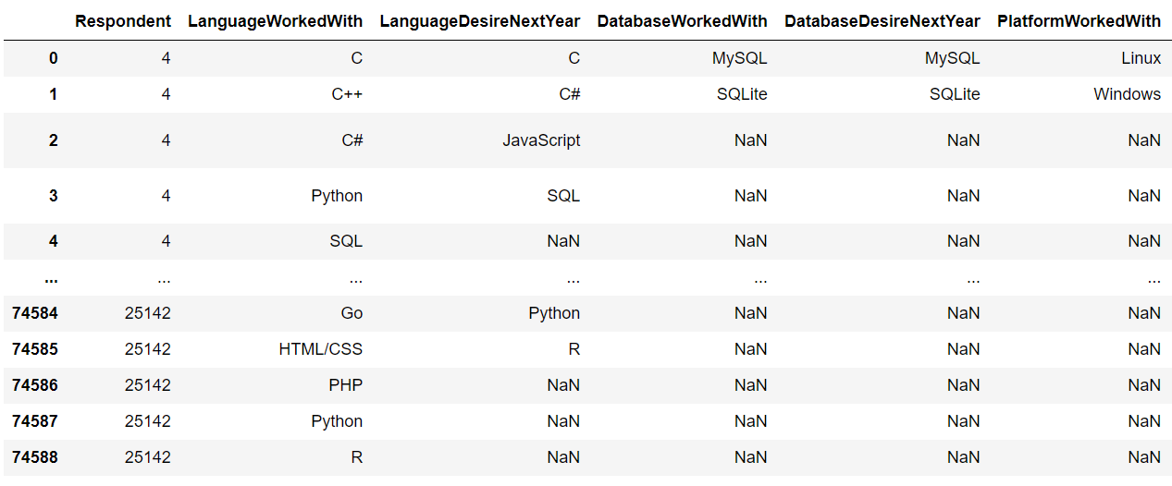
RESULTS

Slide 7
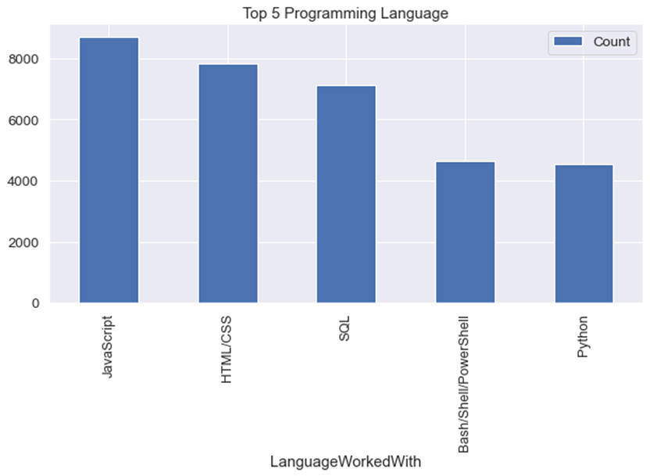
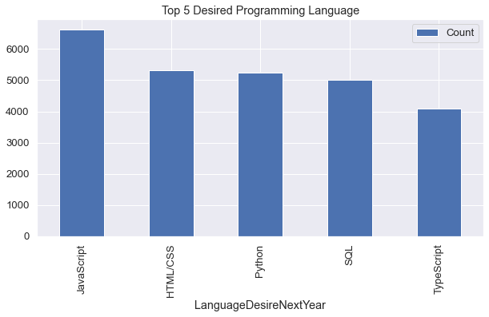
PROGRAMMING LANGUAGE TRENDS
Current Year
Next Year

Slide 8
PROGRAMMING LANGUAGE TRENDS - FINDINGS & IMPLICATIONS
Findings
JavaScript is top trending language in the world
Python and TypeScript are becoming more and more popular
HTML/CSS and SQL still has great portion in language usage trend
Implications
Web developments and Web developers are still in high demands
JavaScript and TypeScript are crucial to learn for developers
Python is the new trending language, especially popular in AI fields

Slide 9
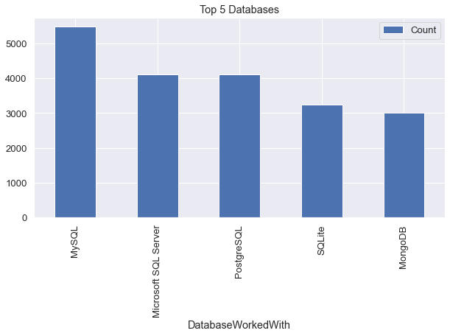
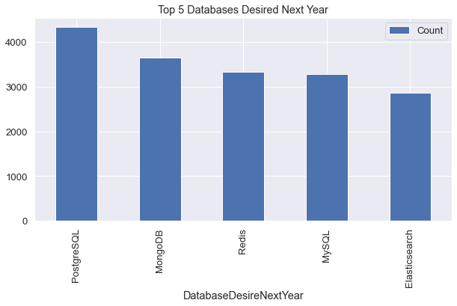
DATABASE TRENDS
Current Year
Next Year

Slide 10
DATABASE TRENDS - FINDINGS & IMPLICATIONS
Findings
MySQL is the most popular database
There are still a lot of companies using Microsoft SQL Server
MongoDB and Redis are the most favorable NoSQL database
Implications
Open-source databases like MySQL are still preferable
Software development and Big Data technology still requires SQL
NoSQL databases will make an impact for relational databases

Slide 11
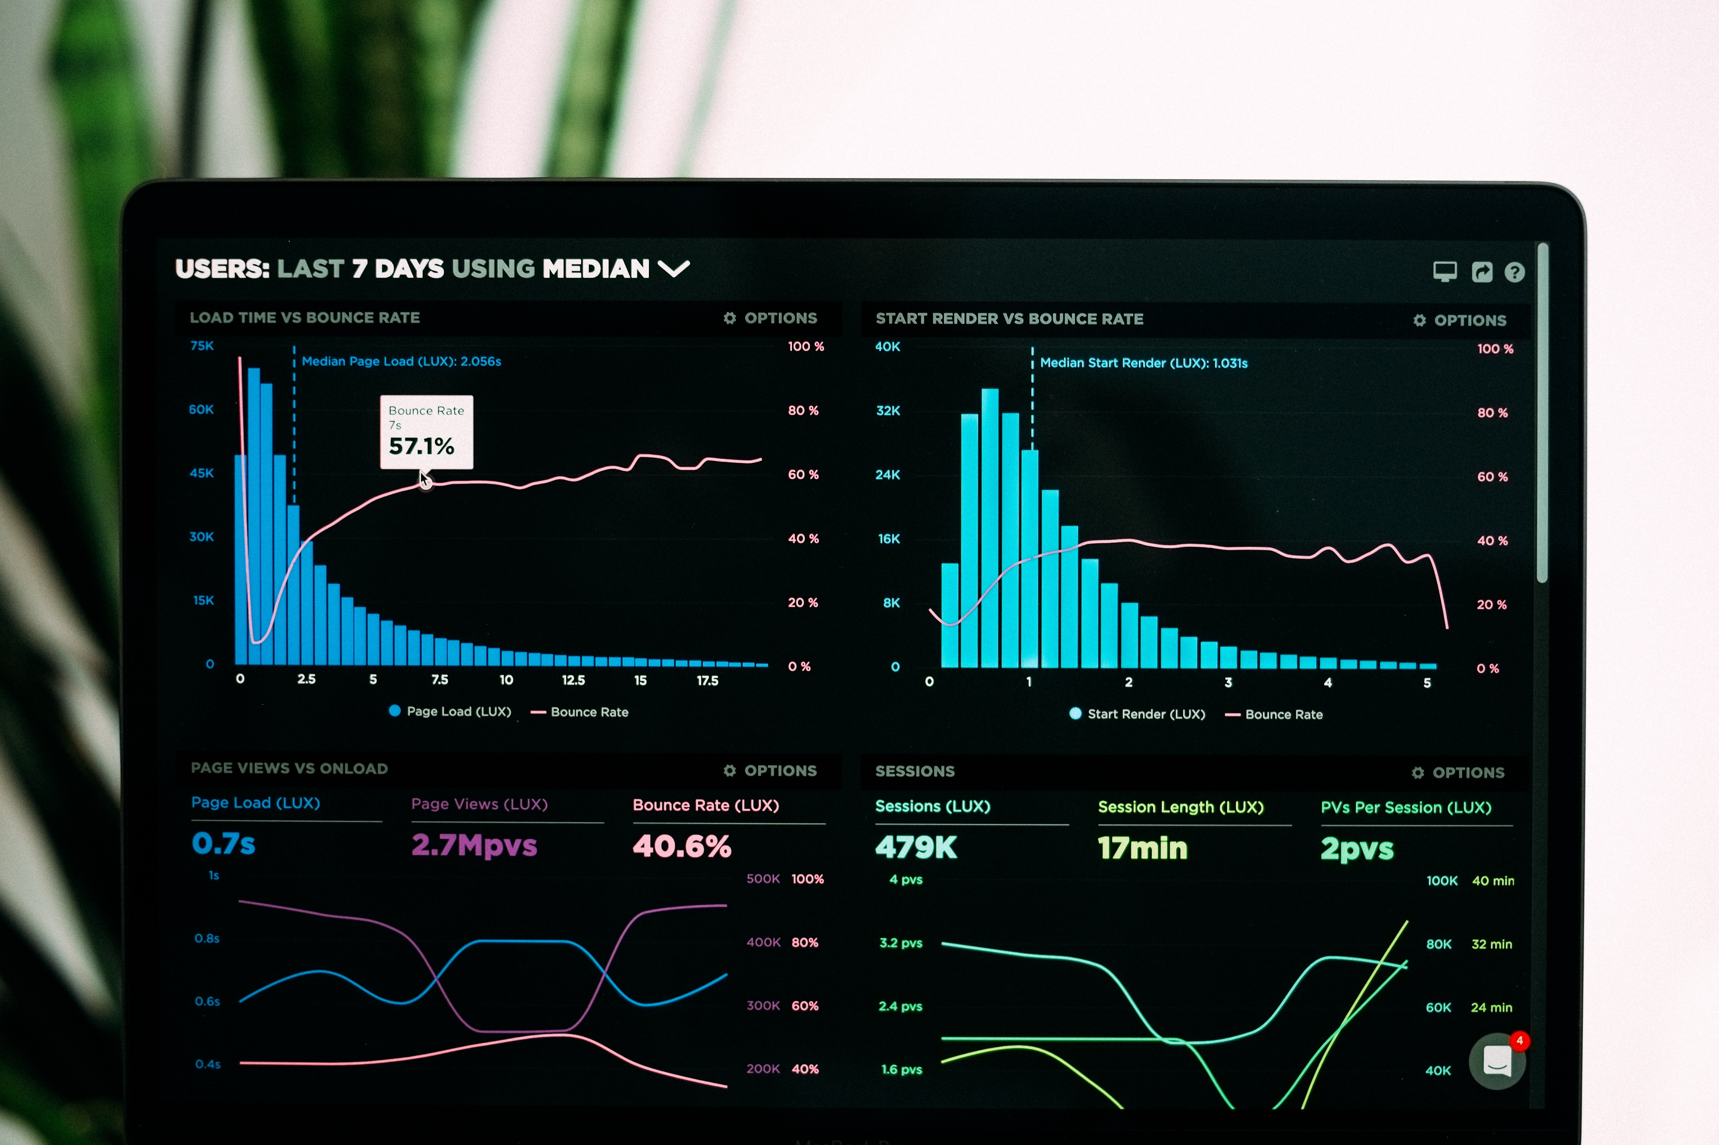

DASHBOARD
The permanent link of the read-only view of the Cognos dashboard:
https://sa1.ca.analytics.ibm.com/bi/?perspective=dashboard&pathRef=.my_folders%2FPeer-Graded%2BAssignment%2BDashboard&action=view&mode=dashboard&subView=model0000018c4584b879_00000003

Slide 12
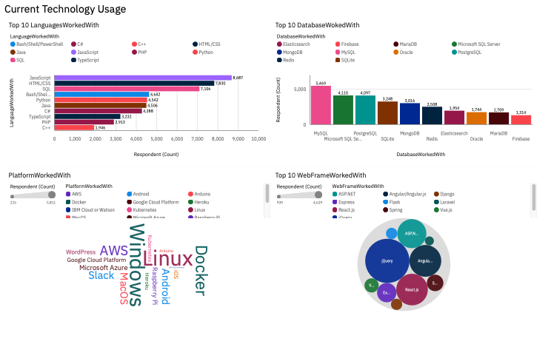
CURRENT TECHNOLOGY USAGE

Slide 13
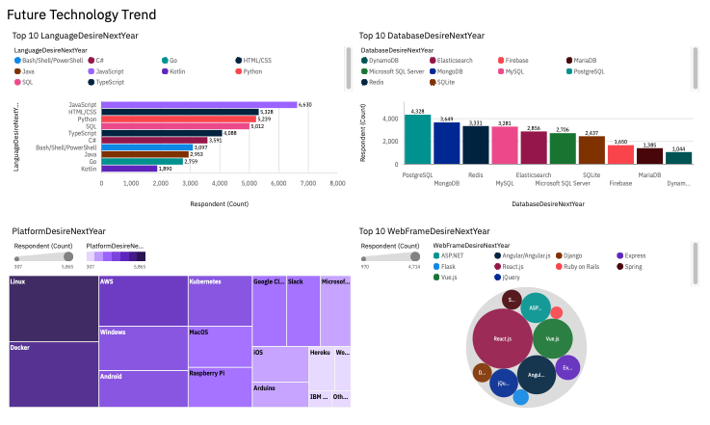
FUTURE TECHNOLOGY TREND

Slide 14
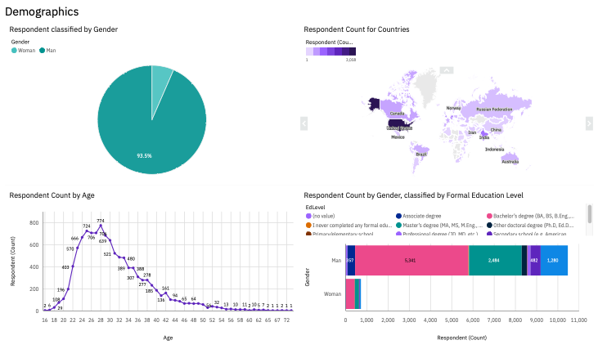
DEMOGRAPHICS

Slide 15

DISCUSSION
Technology Usage Trend Now and Future
Gender, Age and Education Discrimination in IT Industry

Slide 16
OVERALL FINDINGS & IMPLICATIONS
Findings
Technology trends changes every year
USA is the top technology country
There are extreme gender and age discrimination
Docker and AWS are the most popular platform
Implications
Programmers should always follow the latest technology trends
More countries should have the equal chance to be exposed to new technology
Gender and Age should not be one of the concerns or benefits of Employment

Slide 17
CONCLUSION
Continuous adaptation to evolving technology trends is crucial for professionals in the field.
Global efforts should focus on fostering technological advancements beyond geographical boundaries.
Promoting diversity and combating discrimination based on gender and age is essential for a fair and inclusive workforce.
Acknowledging and leveraging popular platforms like Docker and AWS can contribute to technological progress.
Overall, a commitment to staying current, promoting inclusivity, and embracing technology fosters a more robust and equitable future in the tech industry.

Slide 18

APPENDIX

Slide 19
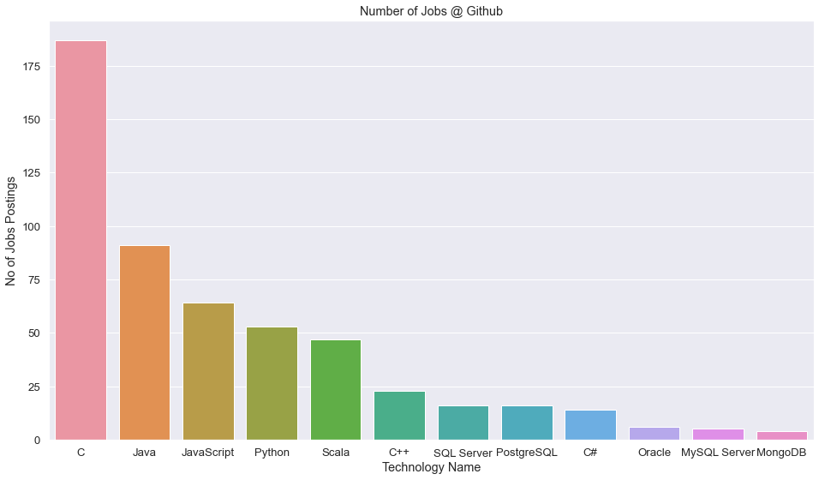
GITHUB JOB POSTINGS

Slide 20
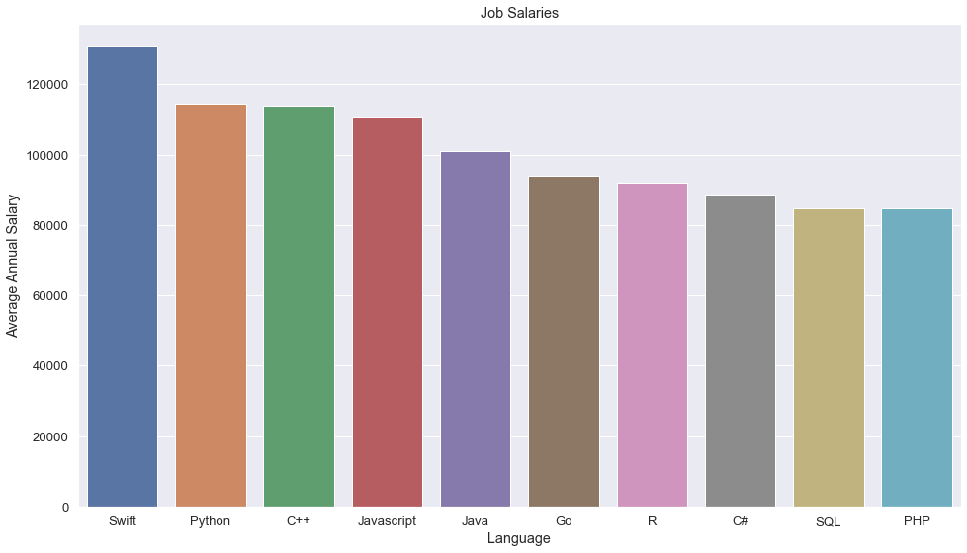
POPULAR LANGUAGES

Slide 21
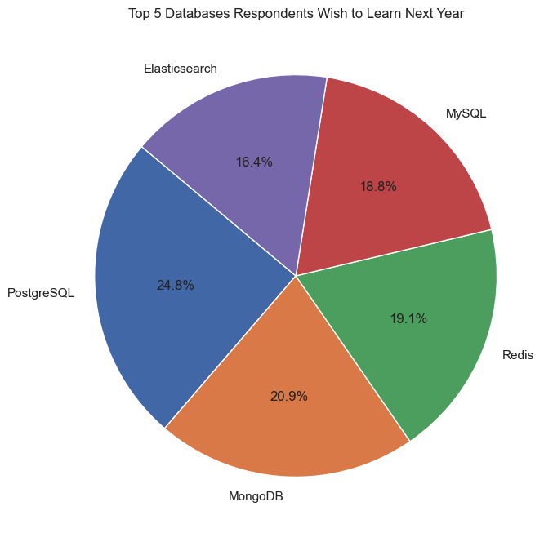
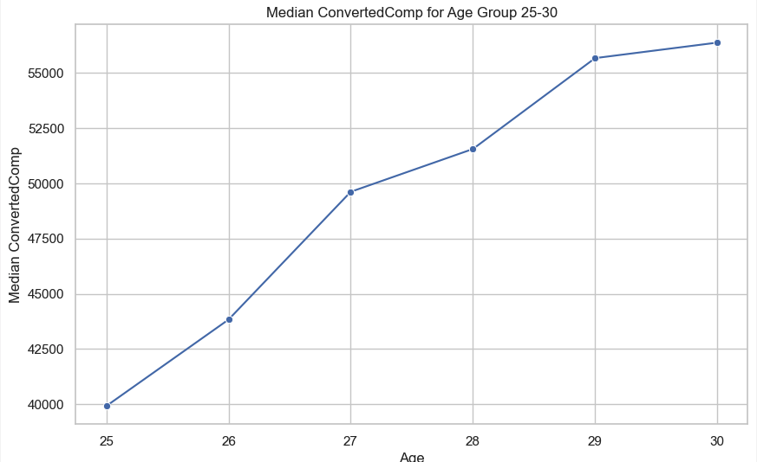
ADDITIONAL VISUALS

